Slide 1

Capstone Engagement
Assessment, Analysis, and Hardening of a Vulnerable System
Alec Gautreaux

Slide 2
Table of Contents
This document contains the following sections:
01
Network Topology
02
Red Team: Security Assessment
03
Blue Team: Log Analysis and Attack Characterization
Hardening: Proposed Alarms and Mitigation Strategies
04

Slide 3

Network Topology

Slide 4
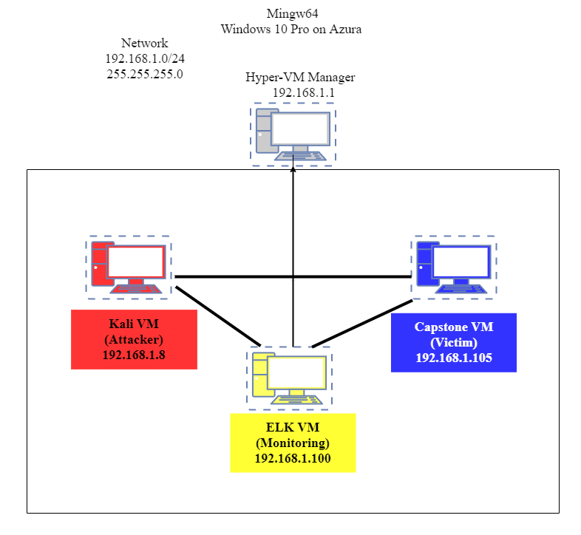
Network Topology
Network: 192.168.1.0/24:
Netmask: 255.255.255.0
Gateway: 192.168.1.1
Machines:
IPv4: 192.168.1.8
OS: Kali Linux
Hostname: Kali (Attacker)
IPv4: 192.168.1.105
OS: Ubuntu 18.04.1
Hostname:Capstone (Victim)
IPv4: 192.168.1.100
OS:Ubuntu 18.04.1
Hostname: ELK ( Monitoring)
IPv4: 192.168.1.1
OS: Windows 10 Pro (Host)
Hostname: Mingw64

Slide 5


Red Team
Security Assessment
Red Team
Security Assessment

Slide 6
Recon: Describing the Target
Nmap identified the following hosts on the network:
Hostname | IP Address | Role on Network
Kali Kali 2020.1 | 192.168.1.8 | Attacker Machine
Capstone Ubuntu 18.04.1 | 192.168.1.105 | Victim Machine
ELK Ubuntu 18.04.4 | 192.168.1.100 | Monitoring Machine
Mingw64 Windows 10 Pro | 192.168.1.1 | Has the hyper-v where Capestone and Kali held on it, Also used to view Kabina on ELK

Slide 7
Vulnerability Assessment
The assessment uncovered the following critical vulnerabilities in the target:
Vulnerability | Description | Impact
Sensitive Data Exposure #1 | By having the index.html file out in the open it showed the directory structure. | Which allowed me to go through figure out directory structure and see what all it had inside to offer.
Sensitive Data Exposure #2 | Unprotected files in the directory that reference a file called “sercet_folder”. Which was a dead give away that’s where to go. | There where a lot of unprotected files that referenced the “sercet_folder” that pointed me in direction of it.
Sensitive Data Exposure #3 | After exposing the required user account for the “sercet_folder” access. Brute force attack would be used to crack the password. | After finding out the required user for the folder I was able to focus on cracking their specific password instead of going cracking all the other passwords.
Sensitive Data Exposure #4 | The “Connect_to_corp_server” file set pathway on how to access the server via webdva with the user/hashed password included. | Which allowed me to be able crack the password and gain access to where I was able to upload reverse payload shell to the server.

Slide 8
Vulnerability Assessment
The assessment uncovered the following critical vulnerabilities in the target:
Vulnerability | Description | Impact
No Brute Force Attack Mitigation | Allows execution of commands that can remotely crack passwords for user on the victim's machine. | I was able to use hydra to crack the user ashton passwords without being detected.
Unauthorized File Upload | Anyone has the ability to upload files to server via webdav. I uploaded (shell.php) | I was able to upload my reverse shell payload to the server.
Remote Code Execution | Uploading the reverse shell payload and running it allowed to me to gain remote access and execution abilities. | I was able to take control of the victim machines.

Slide 9
Exploitation: Sensitive Data Exposure
01
02
03
Tools & Processes
I used nmap to find the target machine. Used the command nmap 192.168.1.0/24 to run the scan. I found out that the target ip address was 192.168.1.105 they had port 80 open. I entered 192.168.1.105 into the browser which opened right to the directory structure because of not having index.html file in place.
Achievements
It allowed me to gain access the victim's machine through the web browser also gave me the keys to castle to able going digging deeper.
Screenshots on next slide showing.

Slide 10
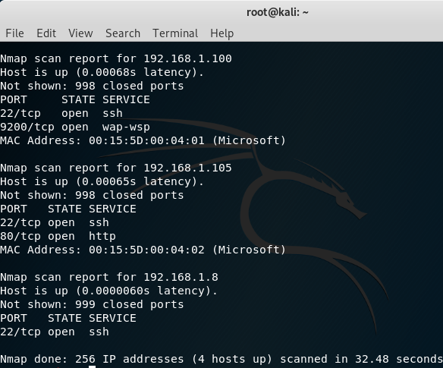
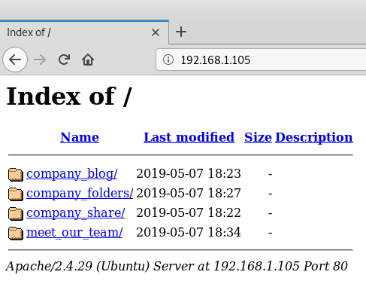
Exploitation: Screenshots #1
Nmap Scan No Index.html, showing exposed structure

Slide 11
Exploitation: Sensitive Data Exposure
01
02
03
Tools & Processes
After gaining access to the victim machine through the browser I was able to go through and do some snooping in the different directories and content inside of them.
Achievements
Which allowed me to dig through all the different files they had to offer which a lot them pointed out to serect_folder that could contain the valuable information Im after.
Screenshots on next slide showing.

Slide 12
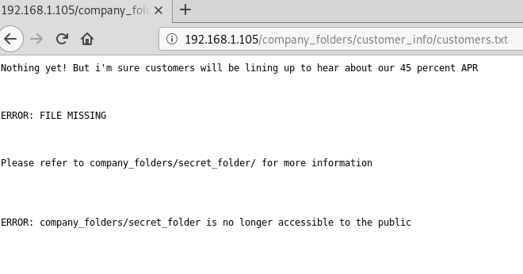
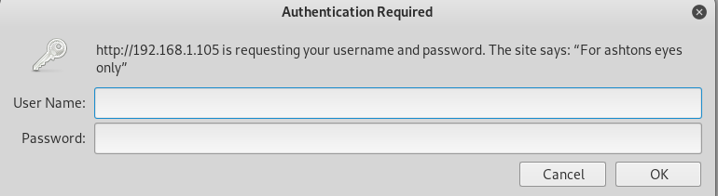
Exploitation: Screenshots #2
One example of many area’s referring to secert_folder Secert_folder password protected

Slide 13
Exploitation: Sensitive Data Exposure and Brute Force Attack
01
02
03
Tools & Processes
Once I saw that ashton was the username for the secret_folder it helped narrow down exactly what user I need to focus brute force attack on.
Achievements
After using the hydra command on the user name ashton I was able brute force my way into fiding there password. Running scan through multiple options till it finally found correct one and pointed it out.
Screenshots add on the other slide.

Slide 14
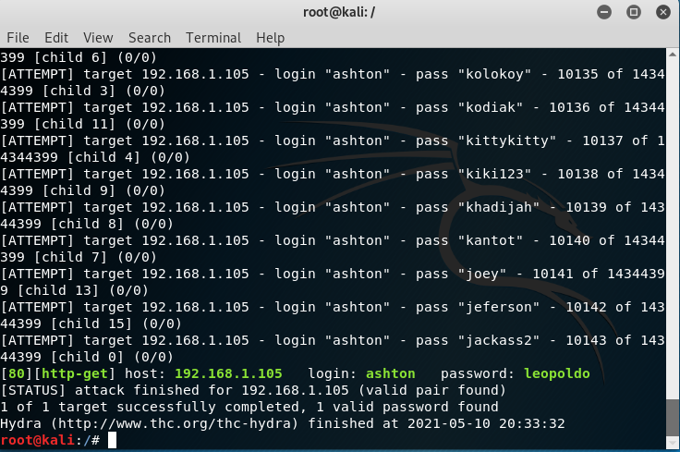
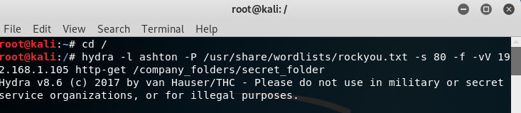
Exploitation: Screenshots #3
Hydra command used on Ashton Successfully Brute Forced password

Slide 15
Exploitation: Sensitive Data Exposure
01
02
03
Tools & Processes
After cracking open the password and accessing the folder it contains contained index and directions to webdav server. This came with the user I would be using and hashed password. I took the hashed password to http://crackstation.net.
Achievements
After using crackstation I was able to get the password and access the webdav server.
Screenshots add on the other slide.

Slide 16
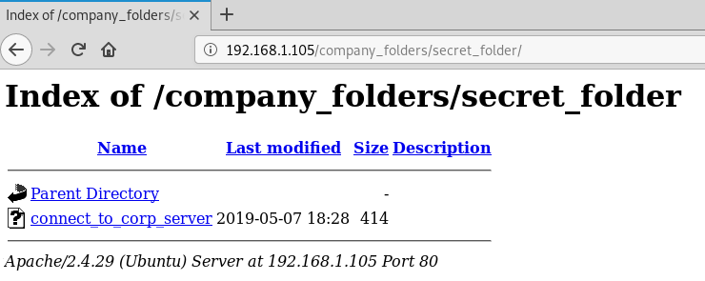
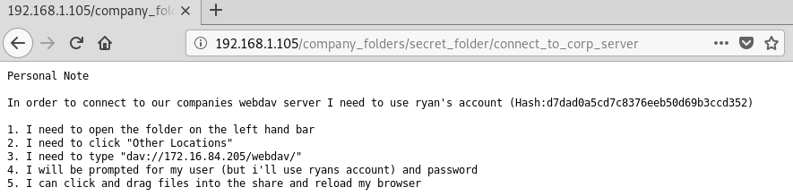
Exploitation: Screenshots #4
Contents of the secret_folder Instructions to access the webdav server

Slide 17
Exploitation: Unauthorized File Upload & Remote Code Execution
01
02
03
Tools & Processes
After I was connected to the target server through the webdav. I was able create and deliver a reverse shell payload to gain full access on the server. Using the msfvenom command and logging into the msfconsole i was able to complete the exploit. .
Achievements
I was able to connect to the server via reverse shell and was able to gain full access.
Screenshots add on the other slides.

Slide 18
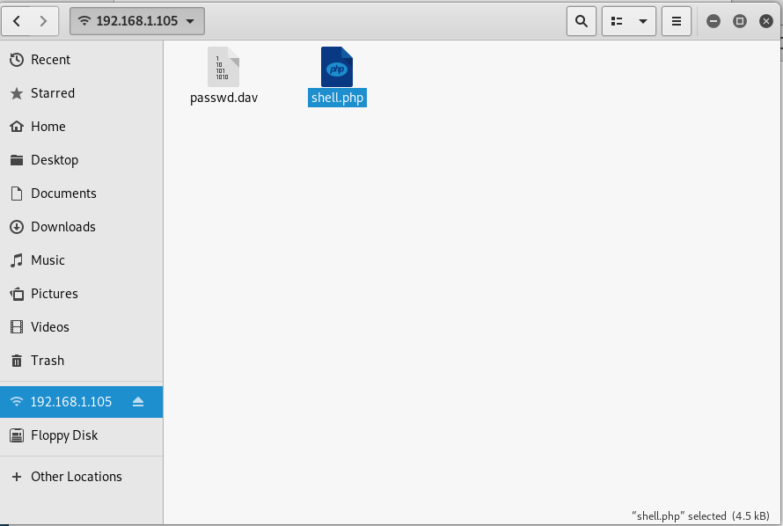
Exploitation: Screenshots #5
Reverse shell being created Delivery of payload to the webdav

Slide 19
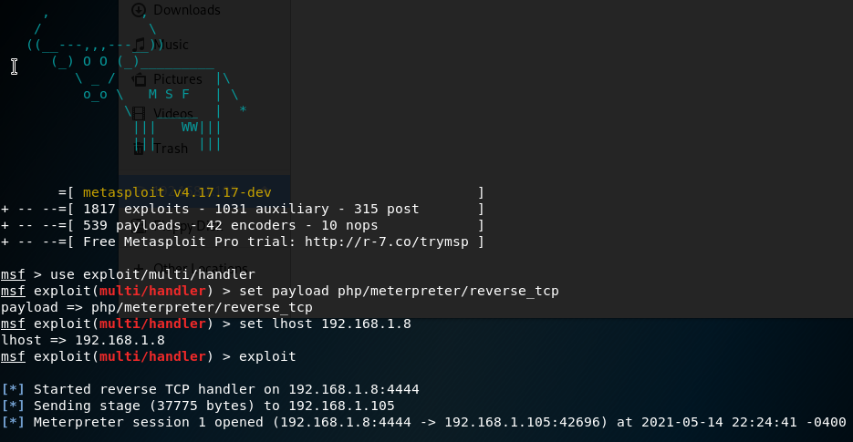
Exploitation: Screenshots #5 part 2
Started handler on attack machine

Slide 20
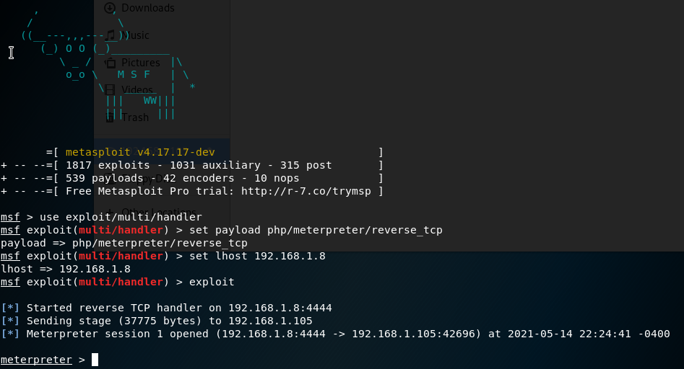
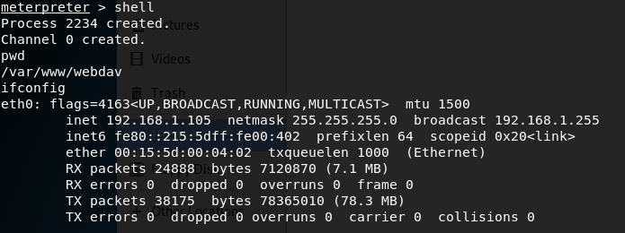
Exploitation: Screenshots #5 part 3
Showing file executed on target machine, connection established Shell running on target machine

Slide 21


Blue Team
Log Analysis and Attack Characterization
Blue Team
Log Analysis and Attack Characterization

Slide 22
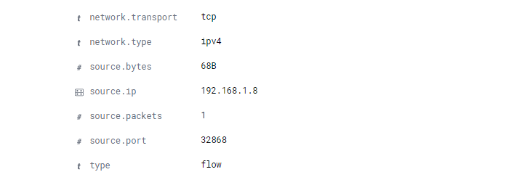
Analysis: Identifying the Port Scan
The port scan occurred on May 11th 2021 @ 01:17:37.715
1 source packet and the IP it was sent form was 192.168.1.8
The source IP was 192.168.1.8 which is different from the destination IP which is 192.168.1.8 also the ports are different from each other the source port is 32868 and the destination port is 80.

Slide 23
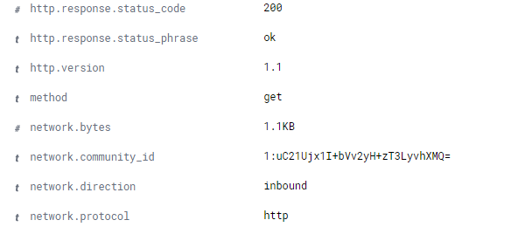
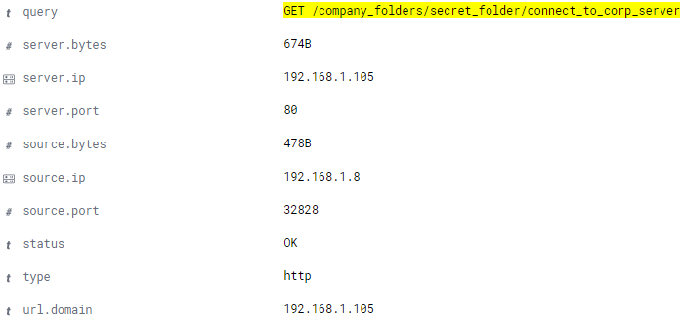
Analysis: Finding the Request for the Hidden Directory
.
The event occurred on May 11th 2021 @ 01:17:37.715
There were 250 request.
It requested the /company_folders/secret_folder.
The folder contained how to connect_to_corp_server.

Slide 24
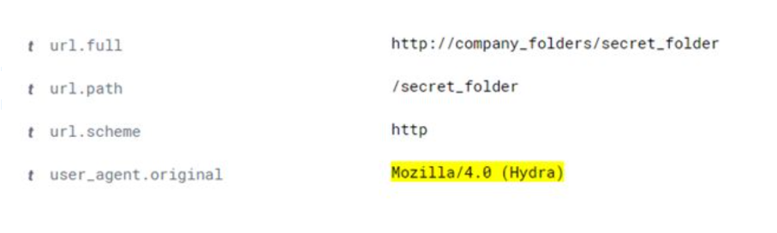
Analysis: Uncovering the Brute Force Attack
There where 10143 attempts to crack the password and there where 1434439 attempts altogether to go through.
It took 10144 out of 1434439 attempts to crack the password.

Slide 25
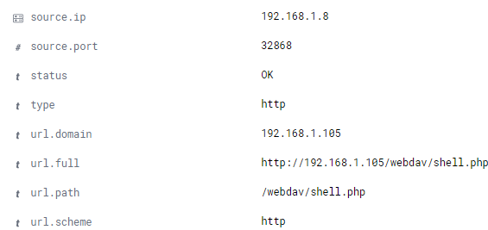
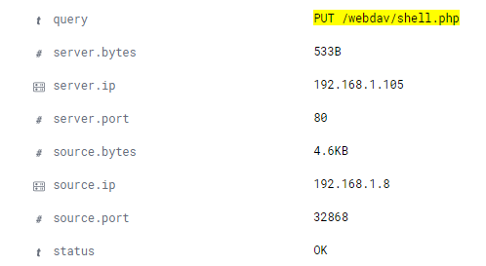
Analysis: Finding the WebDAV Connection
There were 160 request
After cracking the password and getting the correct login information. I was able to upload the shell.php

Slide 26
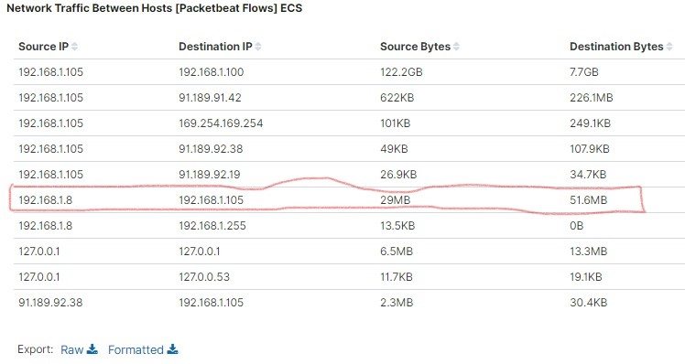
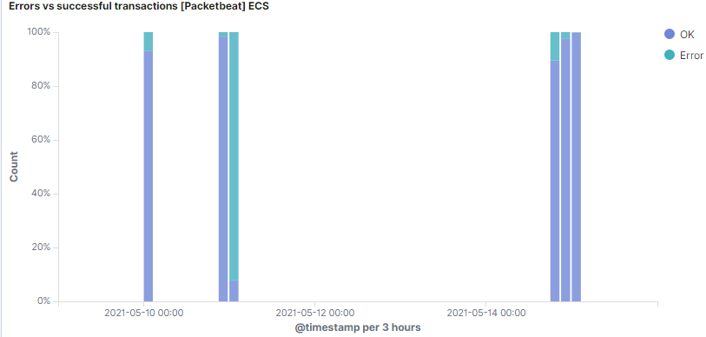
Analysis: Addition Visuals
.
In Kabina I created dashboard I created multiple graphs that show visualizations of the traffic that transpired. The high volume of traffic is due the attacker and victim. A lot the errors that transpired are due to the brute force attack being used until it eventually obatiend the correct password.

Slide 27

Blue Team
Proposed Alarms and Mitigation Strategies
Proposed Alarms and Mitigation Strategies

Slide 28
Mitigation: Blocking the Port Scan
Create alarm notifying if port scans that are not tied the servers IP thats related to company are going tigger the alarm to go off and notify security team.
There is no reason for anyone to be doing port scans that are not apart of security team on the company at all we need to, If someone in the company is not apart of security team another designated team where it would be required to then pull the employee aside talk with them,
Setting up firewall to block outside designated IP source address that are allowed to perform scanning.

Slide 29
Mitigation: Finding the Request for the Hidden Directory
Create a alarm that notifies if anyone tries to connect and digging into the hidden directory alarm goes off right way notifying the security team. There should only be one person and security team that have their IP address white listed.
All other IP address should be black listed beside the certain individual and the security team IP address that should be white listed. That way individual can get in without alarm going off and security team can monitor it check inside it without setting off the alarm when they log into it.

Slide 30
Mitigation: Preventing Brute Force Attacks
Setting up alarm that tracks failed attempts within short period of time. This would be setup for the IP that keeps attempting multiple logins across different accounts that keep failing. Multiple alarms that can be set up for it.
You are able to get 5 attempts to login within 30 sec form the IP. We can change it as needed for real life scenarios. We all at one point or another enter password for different account or miss spell. What we are after is ones that just ramming passwords in fast and hard.
What configuration can be set on the host to block brute force attacks?
Creating stronger passwords ( requiring certain length and symbols)
Use CAPTCHA ( Find all cars in the 8 photos provided)
Two-way Authentication (Emails, Text messages with codes, Phone calls)
Limit login attempts ( blocking ip temporarily requiring a phone call to tech support to unlock account providing proper information for the account involved.)

Slide 31
Mitigation: Detecting the WebDAV Connection
Creating alarm for white listing authorized IP for the WebDAV server and black list all other IP’s. If any of the IP address that are not apart the white list try connect to the it create investigation for them.
Check the IP address to see if it's a part of the white list of the IP address. If it is then see which user was the one accessing it and cross reference see if they are actually needing to be inside the webdav server. Make it so that as little as possible people have access to it.
Make sure that the users who have access to it and the usernames and passwords are more complex. Adding numbers and special characters to them on top of letters to make it harder to brute force into. Also not use employees names as username so that way it makes it harder to phish that could also lead to their passwords being cracked. Adding two authentication is another part that should be added.

Slide 32
Mitigation: Identifying Reverse Shell Uploads
Set alarm that notifies if anyone is setting up files that transfer executationable codes. This way we can see if the someone outside of the company is uploading and also if someone in company is uploading also. That way if someone in company can look see who it is then see what exactly there up to ask hey why are you uploading this code if they are not part of designated team.
Requiring authentication when it comes to uploading files.(Employees login and Password)
By creating a filter that blocks files that are being uploaded with executationable codes inside of them and any extensions that they may have apart of them as well. A header can also be created to make sure that codes are not executable without given proper permission.

Slide 33

The
End

